Slide 1

FINANCIAL ENGINEERING PROJECT Stage 1
POZNAN UNIVERSITY OF ECONOMICS AND BUSINESS
Students:
Tu Anh Nguyen
Thi Kim Phuong Nguyen
Askar Mulkubayev
Osborn Mugaviri

Slide 2

Content
I. FX forward
II. Interest rate swaps

Slide 3
I. FX forward
Notes:
The purpose of an FX forward is to lock in an exchange rate between two currencies at a future date to minimise currency risk. This might be done, for instance, if a company is contractually obliged to pay a set amount for the future delivery of goods in a foreign currency and wishes to lock in the rate.

Slide 4
I. FX forward
An FX forward is a contractual agreement between the client and the bank, or a non-bank provider, to exchange a pair of currencies at a set rate on a future date.
The purpose of an FX forward is to lock in an exchange rate between two currencies at a future date to minimize currency risk.
Forward contracts are one of the main methods used to hedge against exchange rate volatility, as they avoid the impact of currency fluctuation over the period covered by the contract.
Usually used by exporters and importers to hedge their foreign currency payments from exchange rate fluctuations.
Notes:
The purpose of an FX forward is to lock in an exchange rate between two currencies at a future date to minimise currency risk. This might be done, for instance, if a company is contractually obliged to pay a set amount for the future delivery of goods in a foreign currency and wishes to lock in the rate.

Slide 5
I. FX forward
How does FX Forward work?
To establish a FX Forward Contract, you need to select the Sell Currency, Buy Currency, contract tenor, contract amount, and agree the forward rate with the bank, or a non-bank provider. Your deposit in Sell Currency, whether is frozen in your settlement account or held as a time deposit with the provider, will be used for settlement purpose until maturity of the FX Forward.
On Maturity Date, the provider will exercise the FX Forward to convert your deposit into the Buy Currency at the agreed forward rate.
The pricing of the contract is determined by the exchange spot price, interest rate differentials between the two currencies and the length of the contract, which the buyer and the seller decide.

Slide 6

I. FX forward
Price of a currency forward contract:
Covered interest rate parity gives us the no-arbitrage forward price of a unit of foreign currency in terms of the home currency for a currency forward contract of length T in years:
$$F_{T}=S_{0}×\frac{{(1+ R_{PC})}^{T}}{{(1+ R_{BC})}^{T}}$$
Where:
F and S are quotes in price currency per unit of base currency
S₀ : The current spot exchange rate
R_{PC}: Price currency interest rate
R_{BC} : Base currency interest rate
For foreign currency contracts, use a 365-day basis to calculate T if the maturity is given in days
Notes:
The purpose of an FX forward is to lock in an exchange rate between two currencies at a future date to minimize currency risk. This might be done, for instance, if a company is contractually obliged to pay a set amount for the future delivery of goods in a foreign currency and wishes to lock in the rate.

Slide 7

I. FX forward
Payoff formula:
- Short position
$Payoff=F_{T}−$ $S_{T}$
- Long position
$Payoff=$ $S_{T}−F_{T}$
Where:
F_{T} : The FX forward price
S_{T}: The maturity FX spot price at the time T
Notes:
The purpose of an FX forward is to lock in an exchange rate between two currencies at a future date to minimize currency risk. This might be done, for instance, if a company is contractually obliged to pay a set amount for the future delivery of goods in a foreign currency and wishes to lock in the rate.

Slide 8
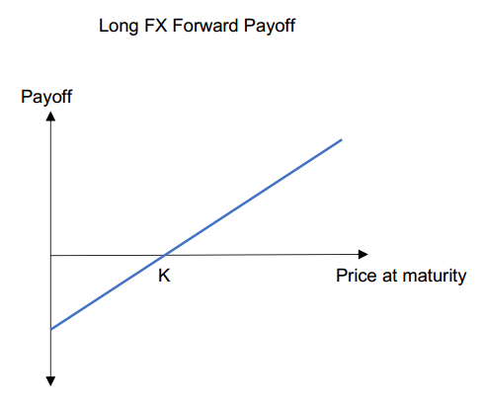
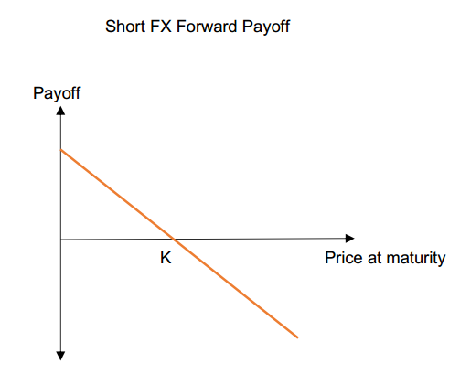
I. FX forward
Payoff
Notes:
Payoff

Slide 9
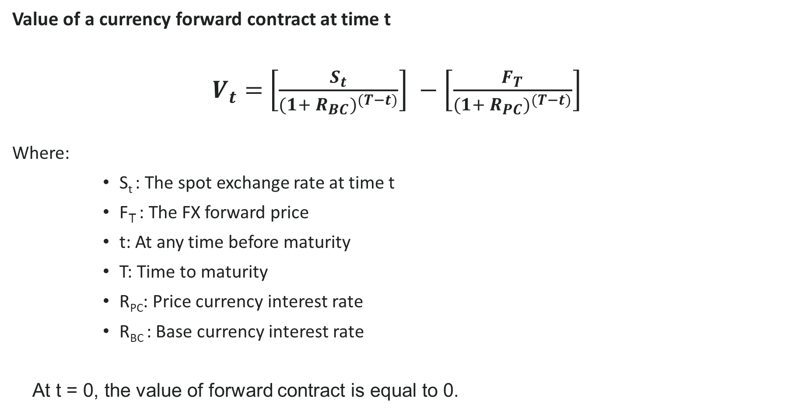
I. FX forward
Value of a currency forward contract at time t
$V_{t}=$ $\left[\frac{S_{t}}{{(1+ R_{BC})}^{(T−t)}}\right] −\left[\frac{F_{T}}{{(1+ R_{PC})}^{(T−t)}}\right]$
Where:
S_{t} : The spot exchange rate at time t
F_{T} : The FX forward price
t: At any time before maturity
T: Time to maturity
R_{PC}: Price currency interest rate
R_{BC} : Base currency interest rate
At t = 0, the value of forward contract is equal to 0.
Notes:
At any time before maturity, the value of a currency forward contract to the long will depend on the spot rate at time t, St

Slide 10
I. FX forward
Example:
Buy EUR sell PLN FX Forward (maturity: 3 year, notional: 1 000 000 EUR; strike: 5.1402)
Assuming that the spot FX rate at the maturity date: 4.9560.
The payoff of buyer:
Payoff = 1 000 000*(4.9560 - 5.1402) = -184 200 PLN
→ The buyer lost 184 200 PLN in this FX forward contract

Slide 11
II. Interest rate swaps

Slide 12
II. Interest rate swaps Mechanics of interest rate swap
Definition
Input data
Input data for the IRS:
notional principal amount,
start and end dates (tenor),
fixed rate (i.e. swap rate),
floating interest rate index and tenor (plus spread over index, if needed),
day count convention
other parameters.
In an interest rate swap (IRS), one party agrees to pay another one cash flows equal to interest at a predetermined fixed rate on a notional principal for a predetermined period of time. In return, it receives interest at floating rate on the same notional principal for the same period of time from the other party.
Other information
Fixed for floating IRS is also called ‘plain vanilla’ swap Interest rates swaps represent up to 60% of global OTC derivative market according to BIS data It is considered a linear interest rate derivative In most IRSs the floating rate is LIBOR IRSs are generally used to hedge against or speculate on changes in interest rates

Slide 13
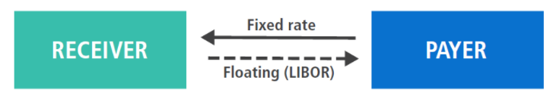
II. Interest rate swaps Mechanics of interest rate swap
Roles in the interest rate swap
Example of interest rate swap
Libor-3m
Company 1
(receiver)
Company 2
(payer)
3%

Slide 14
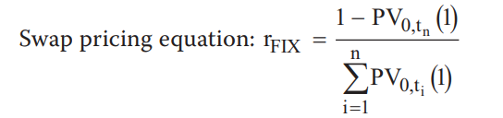
II. Interest rate swaps Mechanics of interest rate swap
Setting up fixed swap rate
The fixed rate must be set so that the values of the floating-rate bond and the fixed-rate bond are the same at swap initiation. By finding this rate, we can price a swap with zero value at the inception of the contract. To find the swap rate R, we set the present values of the interest to be paid under each loan equal to each other and solve for R.
Where PV0,tn is the present value factor for the n-th fixed cash flow PV0,ti is the present value factor for the each i-th fixed cash flow

Slide 15
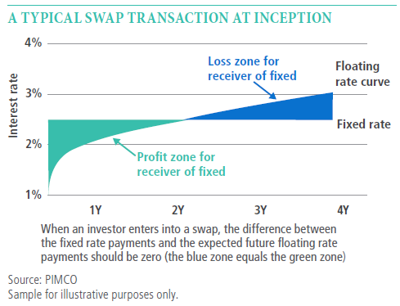
II. Interest rate swaps Payoff of interest rate swap
Graphical representation

Slide 16
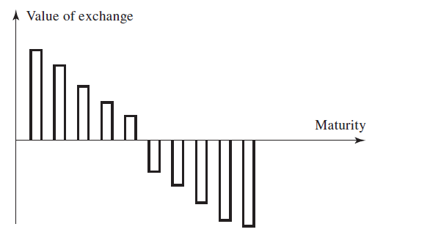
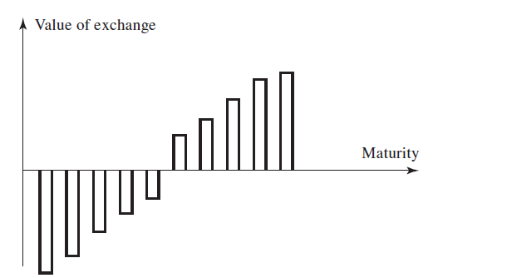
II. Interest rate swaps Payoff of interest rate swap
Graphical representation (2)
The fixed rate in an interest rate swap is chosen so that the swap is worth zero initially. This does not mean that each cash flow exchange in the swap is worth zero initially
a) In upward sloping term structure of rates value of exchange decrease with maturity for receiver of fixed leg
b) In downward sloping term structure of rates value of exchange increase with maturity for receiver of fixed leg

Slide 17
II. Interest rate swaps Payoff of interest rate swap
Table representation
Company 1 pays 3% fixed quarterly and receives Libor-3m on a USD 100m notional amount for two years.
Date | Libor-3m | Floating leg CF received | Fixed leg CF paid | Net cash flow
June 8, 2022 | 2.2% | 550 | 750 | -200
Sep 8, 2022 | 2.6% | 650 | 750 | -100
Dec 8, 2022 | 2.8% | 700 | 750 | -50
Mar 8, 2023 | 3.1% | 775 | 750 | +25
June 8, 2023 | 3.3% | 825 | 750 | +75
Sep 8, 2023 | 3.4% | 850 | 750 | +100
Dec 8, 2023 | 3.6% | 900 | 750 | +150
Mar 8, 2024 | 3.8% | 950 | 750 | +200

Slide 18
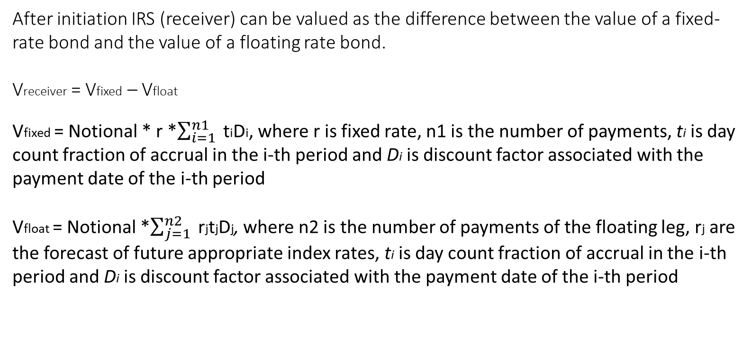
II. Interest rate swaps Valuation of interest rate swap
At initiation an interest rate swap is constructed to have 0 (or close to 0) value.
IRS as a difference in value of two bonds
After initiation IRS (receiver) can be valued as the difference between the value of a fixed-rate bond and the value of a floating rate bond. Vreceiver = Vfixed – Vfloat Vfixed = Notional * r *$\sum_{i=1}^{n1}{ }$tiDi, where r is fixed rate, n1 is the number of payments, ti is day count fraction of accrual in the i-th period and Di is discount factor associated with the payment date of the i-th period Vfloat = Notional *$\sum_{j=1}^{n2}{ }$rjtjDj, where n2 is the number of payments of the floating leg, rj are the forecast of future appropriate index rates, ti is day count fraction of accrual in the i-th period and Di is discount factor associated with the payment date of the i-th period

Slide 19
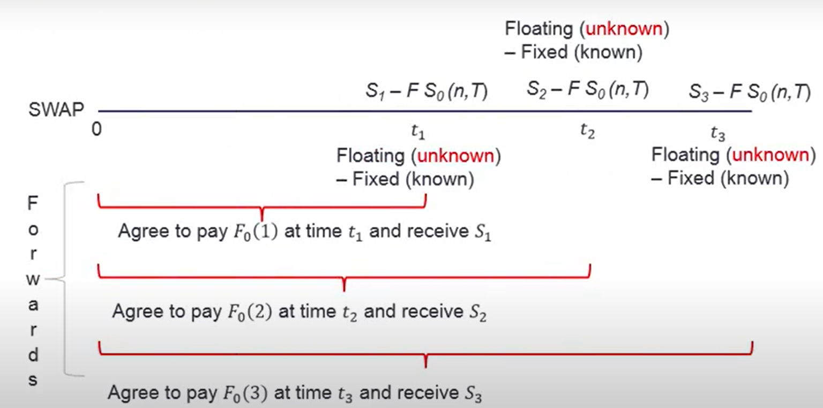
II. Interest rate swaps Valuation of interest rate swap
IRS as a portfolio of FRAs
Alternatively, IRS can be valued as a portfolio of forward rate agreements (FRAs) For each FRA the value is defines as VFRA=Notional*(Rk-Rf)*(T2-T1)*e^(-R2*T2)

Slide 20
II. Interest rate swaps Sensitivity of IRS to change in market rate
Duration of interest rate swap as measure of sensitivity to change in market rate
Duration of fixed leg has standard positive duration of a fixed coupon bond. For example, for 5-year quarterly paying 5% fixed rate bond with 5% market rate modified duration will be 4.4 years. The floating leg has a slightly positive duration equalling to the time until the date of interest rate reset, i.e. ~ 0.25 years. Therefore, net duration of receiver IRS is 4.4-0.25 = 4.15 years for 5 year swap and -4.15 for payer IRS. Duration of a bond is used as a approximate measure of sensitivity of value of bond to change in market rate.
If market rate goes up by 1%
If market rate goes down by 1%
The value of receiver IRS will go down by ~4.1%
The value of receiver IRS will go up by ~4.1%

Slide 21
Thank you for listening!

